Slide 1
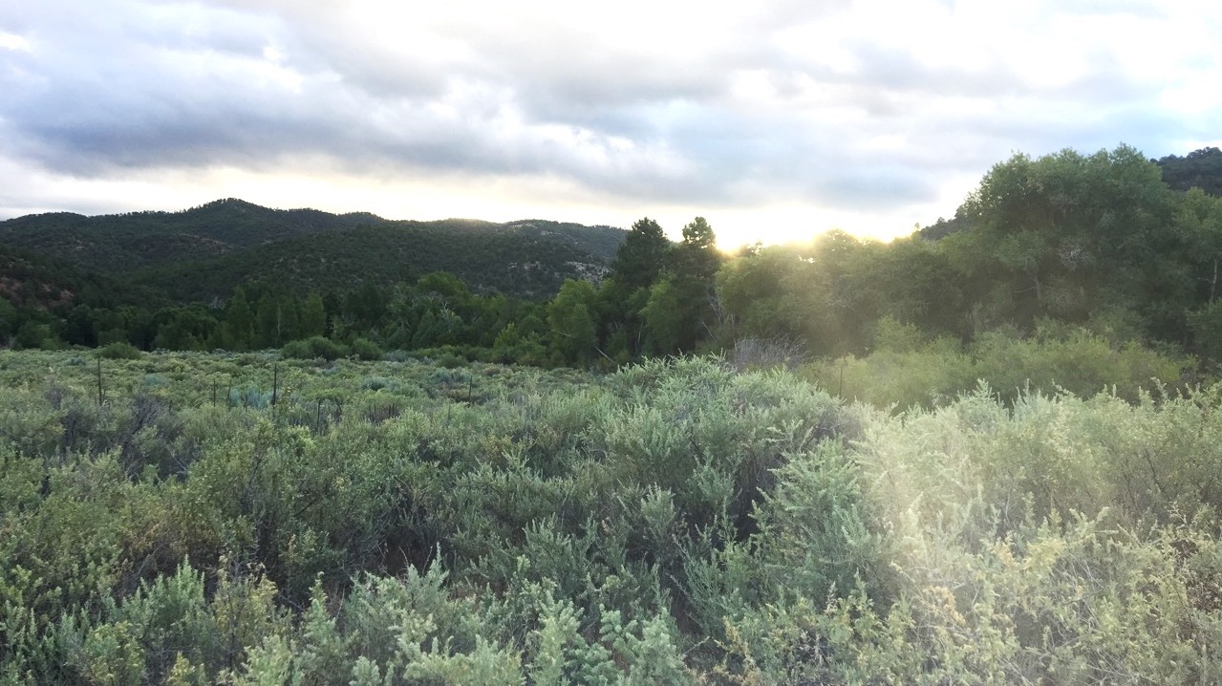
Plants in the Climate System
Nick Smith
Department of Biological Sciences
Texas Tech University
nick.smith@ttu.edu

Slide 2
Why do people care about plants?
nick.smith@ttu.edu

Slide 3
Why do people care about plants?
nick.smith@ttu.edu

Slide 4
Why do people care about plants?
nick.smith@ttu.edu

Slide 5
Why do people care about plants?
nick.smith@ttu.edu

Slide 6
Why do people care about plants?
nick.smith@ttu.edu

Slide 7
Why do people care about plants?
nick.smith@ttu.edu

Slide 8
Why do people care about plants?
nick.smith@ttu.edu

Slide 9
Why do people care about plants?
nick.smith@ttu.edu

Slide 10
Why do people care about plants?
nick.smith@ttu.edu

Slide 11
But plants also affect climate!
nick.smith@ttu.edu

Slide 12
Plant influence on climate
nick.smith@ttu.edu
Carbon uptake
Evapotranspiration (energy transfer)
Albedo (surface color)

Slide 13
Plant influence on climate
nick.smith@ttu.edu
Carbon uptake
Evapotranspiration (energy transfer)
Albedo (surface color)

Slide 14
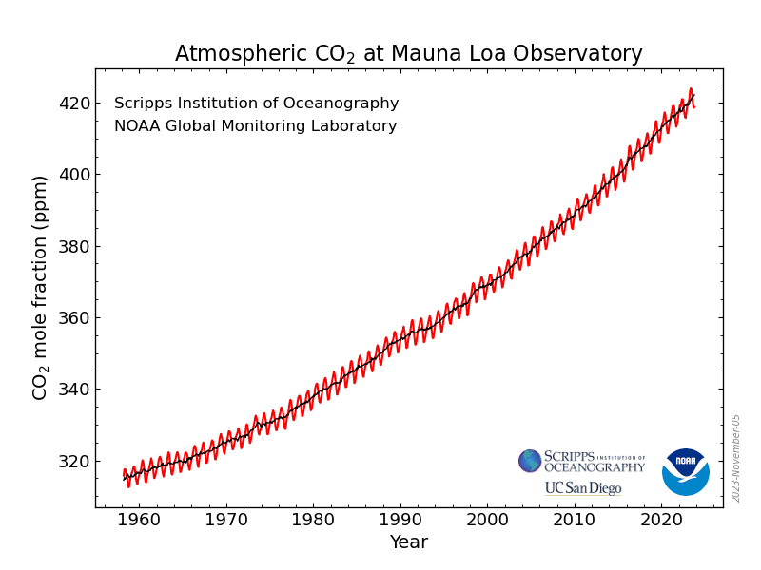
nick.smith@ttu.edu

Slide 15
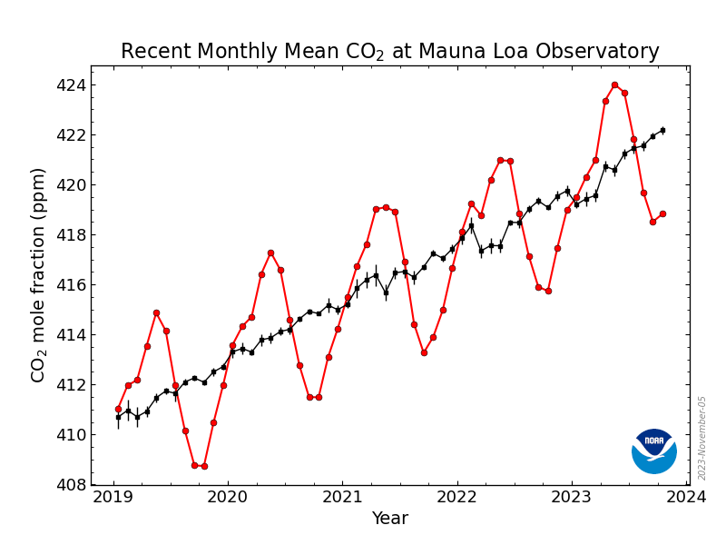
nick.smith@ttu.edu

Slide 16
nick.smith@ttu.edu
Plants!

Slide 17
nick.smith@ttu.edu
Plants!
Plants taking up CO₂ during summer

Slide 18
nick.smith@ttu.edu
Plants!
Plants senescing in fall

Slide 19
Plant influence on climate
nick.smith@ttu.edu
Carbon uptake
Evapotranspiration (energy transfer)
Albedo (surface color)

Slide 20
Plants influence surface energy fluxes
nick.smith@ttu.edu
Transpiration cools the land surface
NASA

Slide 21
Plant influence on climate
nick.smith@ttu.edu
Carbon uptake
Evapotranspiration (energy transfer)
Albedo (surface color)

Slide 22
Plants influence Earth’s color
nick.smith@ttu.edu
Darker = more energy absorbed = warmer

Slide 23
So, to know climate, we need to model plants
nick.smith@ttu.edu
Notes:
Modeling plants is hard! Biology does not have hard and fast rules like physics. Individuals vary even at very small scales!

Slide 24

So, to know climate, we need to model plants
nick.smith@ttu.edu
f (X, Y, Z)
Notes:
Modeling plants is hard! Biology does not have hard and fast rules like physics. Individuals vary even at very small scales!

Slide 25
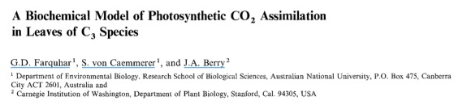
1980’s: plant models are developed
nick.smith@ttu.edu

Slide 26
90’s to 2000’s: spinach world!
nick.smith@ttu.edu

Slide 27
2000’s: 5 – 10 plant “types”
nick.smith@ttu.edu
Broadleaf tree
Needleleaf tree
Deciduous tree
Shrub
Grass

Slide 28
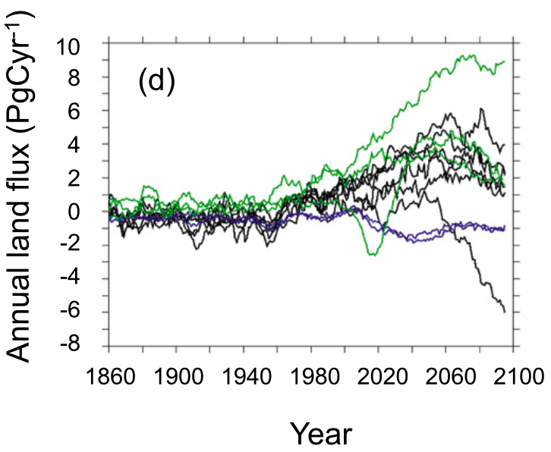
…but the models still vary
nick.smith@ttu.edu
Carbon sink
Carbon source
Friedlingstein et al. (2014)
Notes:
However, these land surface processes that drive the global carbon cycle are very uncertain. In fact, LSMs don’t even agree whether the land surface will be a source or a sink of carbon in the future.

Slide 29
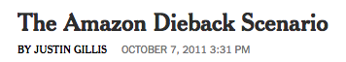
nick.smith@ttu.edu
And some make scary predictions!
Carbon sink
Carbon source
Friedlingstein et al. (2014); New York Times
Notes:
However, these land surface processes that drive the global carbon cycle are very uncertain. In fact, LSMs don’t even agree whether the land surface will be a source or a sink of carbon in the future.

Slide 30
nick.smith@ttu.edu
Dumb plants

Slide 31
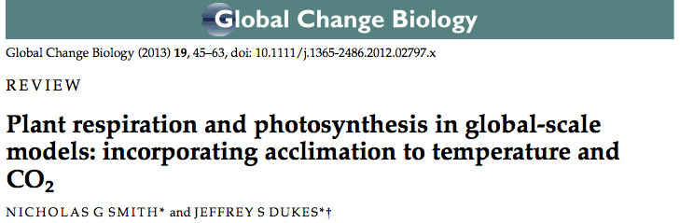
2010’s: “Smart” plants
nick.smith@ttu.edu
With time, plants will acclimate to environmental perturbations, such as elevated temperature and CO₂.

Slide 32
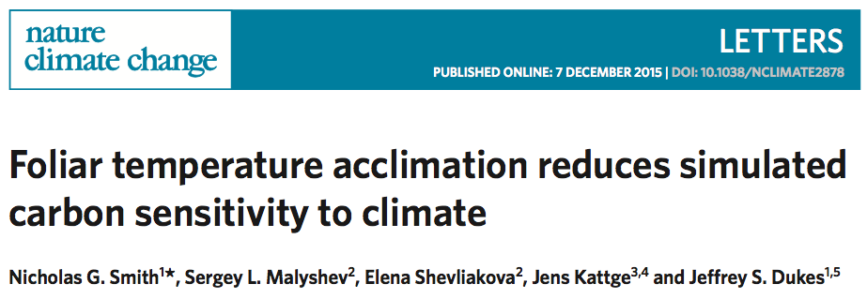
2010’s: “Smart” plants
nick.smith@ttu.edu
Acclimation reduces plant sensitivity to climate.

Slide 33
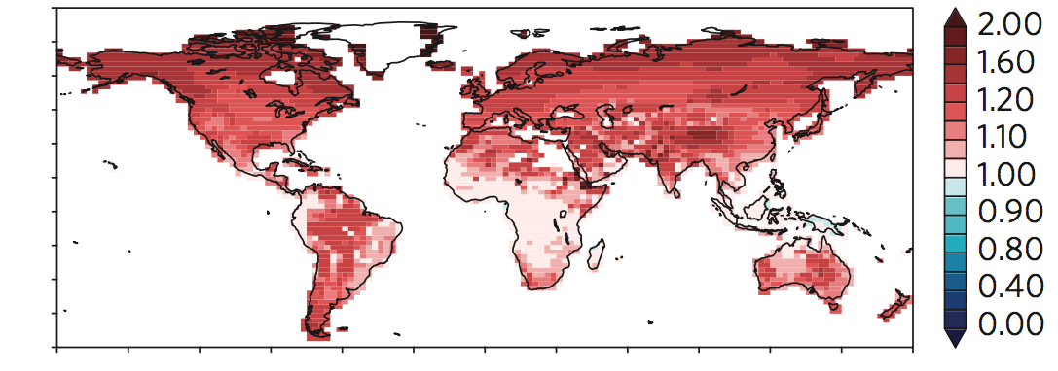

2010’s: “Smart” plants
nick.smith@ttu.edu
Acclimation reduces plant sensitivity to climate, which increases future carbon uptake (no Amazon dieback).
Effect of acclimation on future photosynthetic capacity (µmol m⁻² s⁻¹).
Note: 1: no change; >1: increase; <1: decrease

Slide 34
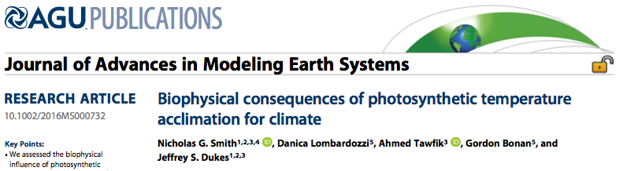
2010’s: “Smart” plants
nick.smith@ttu.edu
Acclimation reduces plant sensitivity to climate, which increases future evaporative cooling.

Slide 35
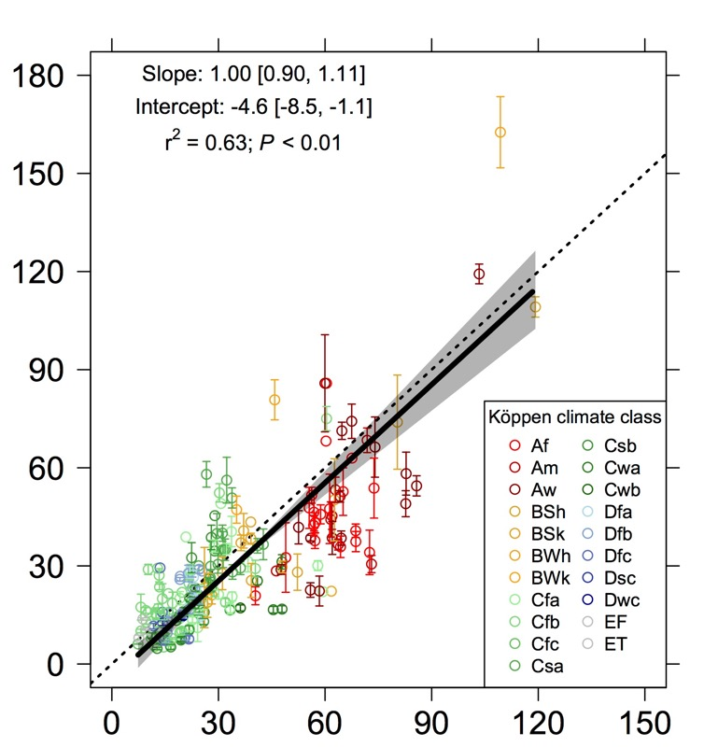
2010’s: “Smart” plants
nick.smith@ttu.edu
A theoretical model of acclimation to everything!
Temperature
CO₂
Light
Moisture
Obs. photosynthetic capacity (µmol m⁻² s⁻¹)
Pred. photosynthetic capacity (µmol m⁻² s⁻¹)
Smith et al. (in review)

Slide 36
… but how do humans fit in?
nick.smith@ttu.edu

Slide 37
2020’s: adding in the human dimension
nick.smith@ttu.edu

Slide 38
2020’s: adding in the human dimension
nick.smith@ttu.edu
Example: What happens when you plant cover crops?

Slide 39
2020’s: adding in the human dimension
nick.smith@ttu.edu
Example: What happens when you plant cover crops?
Increase carbon uptake (cooling)

Slide 40
2020’s: adding in the human dimension
nick.smith@ttu.edu
Example: What happens when you plant cover crops?
Increase carbon uptake (cooling)
Increase evapotranspiration (cooling)

Slide 41
2020’s: adding in the human dimension
nick.smith@ttu.edu
Example: What happens when you plant cover crops?
Increase carbon uptake (cooling)
Increase evapotranspiration (cooling)
Change energy reflection/albedo (warming/cooling)

Slide 42
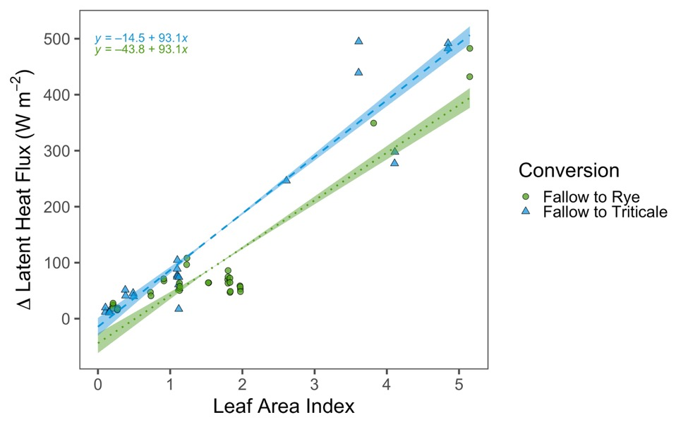
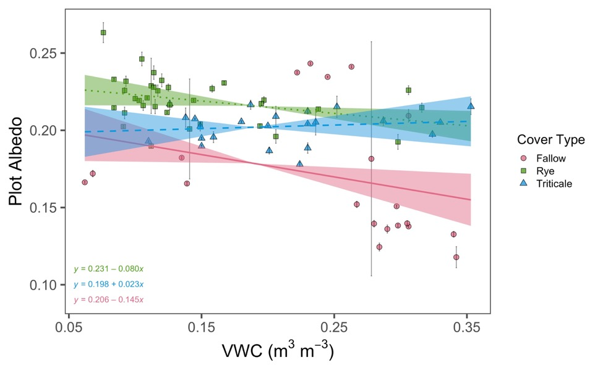
2020’s: adding in the human dimension
nick.smith@ttu.edu
McNellis et al. (accepted)

Slide 43


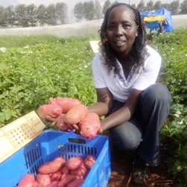

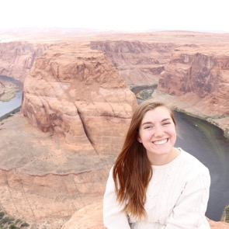
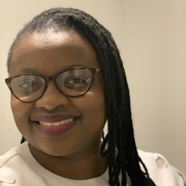
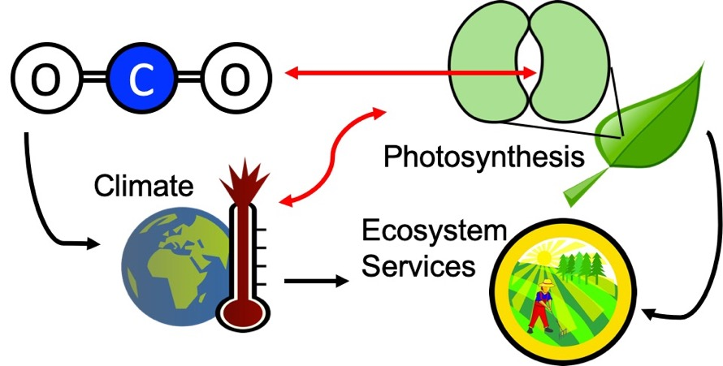

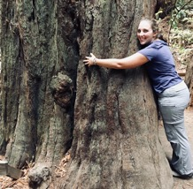
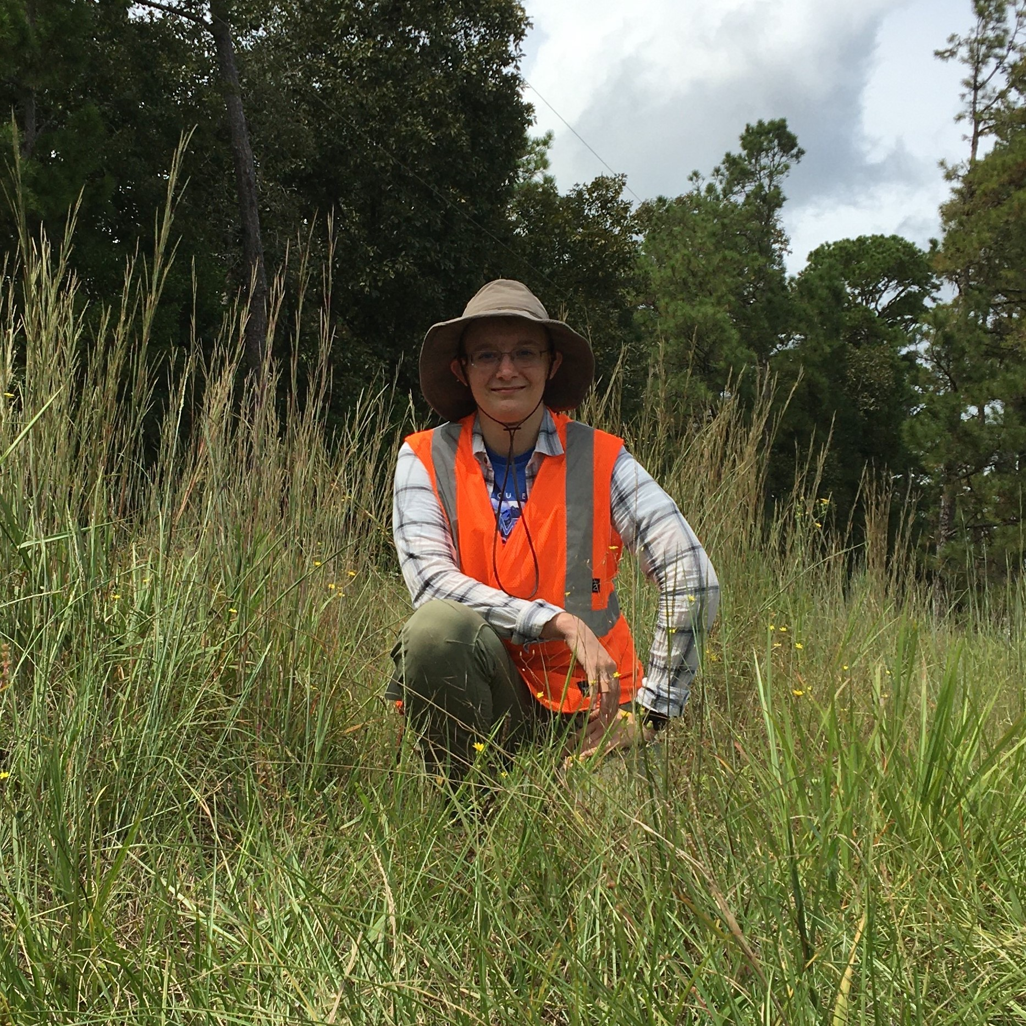
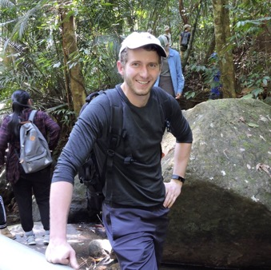

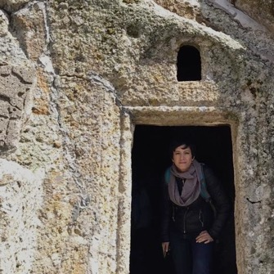
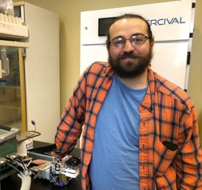
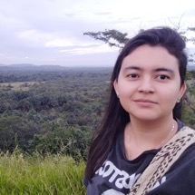

Smith Ecophysiology Lab at TTU
nick.smith@ttu.edu
How do plants respond and feedback to climate over large spatial and temporal scales?
How is human activity modifying plant-climate feedbacks?
Can we build robust, reliable models to represent these responses?

Slide 44
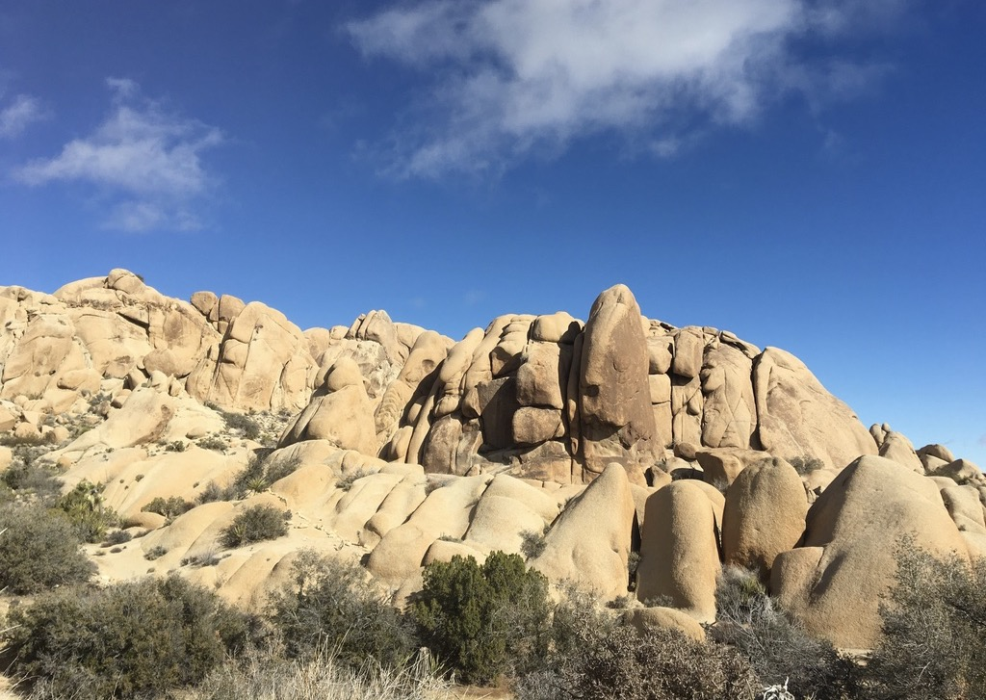
Presentation available at:
www.github.com/SmithEcophysLab/seminar/2023_sbtg
Nick Smith
nick.smith@ttu.edu
Thanks!

